Slide 1
Programming Assessment
The idea of screening about 100 English books for students in poor areas of China
YueYang(Freddie) Liu

Slide 2
Introduction to the dataset and its significance
The raw dataset contains 25 variables and 52478 records corresponding to books on the GoodReads Best Books Ever list.【After filtering, I selected 114 books that met the requirements】
Book Information: Each row represents a book, with details like ‘bookId’, ‘title’, ‘author’, ‘rating’, ‘description’, ‘language’, ‘isbn’, and more.
Categorization: Books are categorized by ‘series’, ‘genres’, and ‘characters’. This could be useful for understanding the diversity of the collection.
Ratings and Popularity: Data such as ‘numRatings’, ‘ratingsByStars’, and ‘likedPercent’ indicate each book's popularity and reception.
Additional Details: ‘setting’, ‘coverImg’, ‘price’, and ‘Lexile’(collected by myself) provide further insights into each book's content and level.

Slide 3
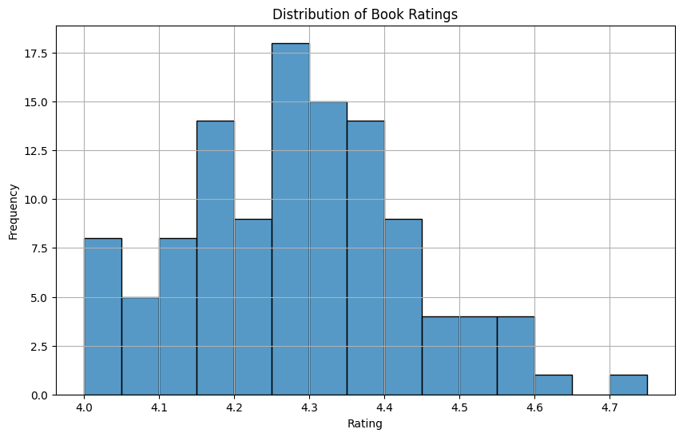
Summary Statistics
The average rating of the books is approximately 4.28
The bar chart shows a concentration of books with ratings around 4.2 to 4.4.
This indicates a generally high quality of books selected.

Slide 4
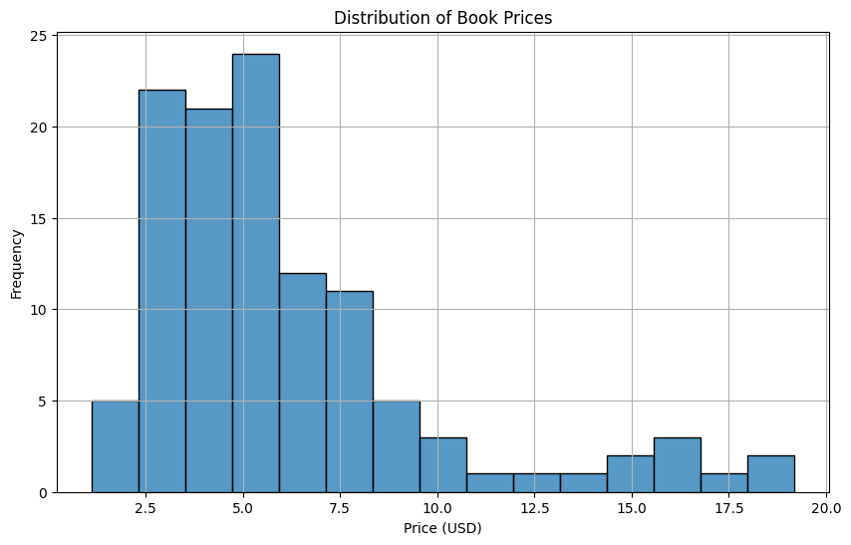
Summary Statistics
The average price of the books is around $6.07, with a range from $1.12 to $19.17.
Prices are fairly evenly distributed, with a slight skew towards the lower end.
This shows the collection is cost-effective while maintaining quality.

Slide 5
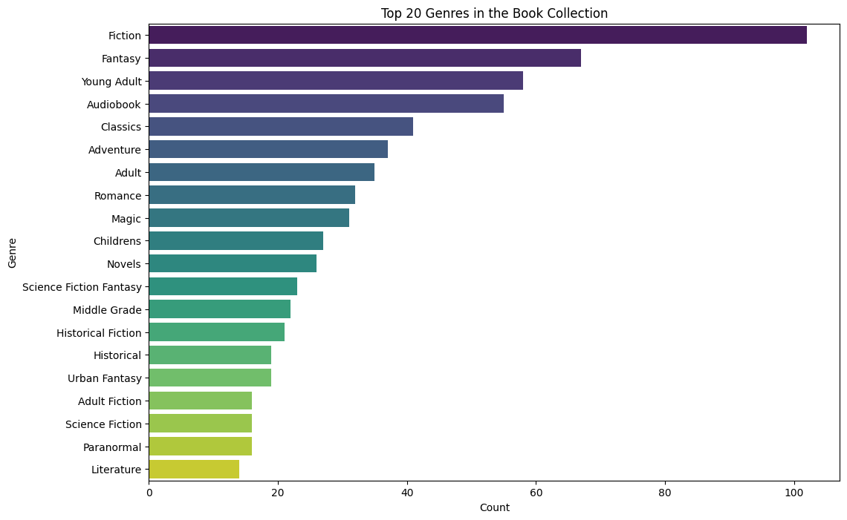
Visualization
The bar chart displays the variety and prevalence of genres.This diversity ensures that the library can cater to a wide array of interests.
The popularity of fantasy novels is much higher than literature (less than $20), but I realize that literature are often not cheap.

Slide 6
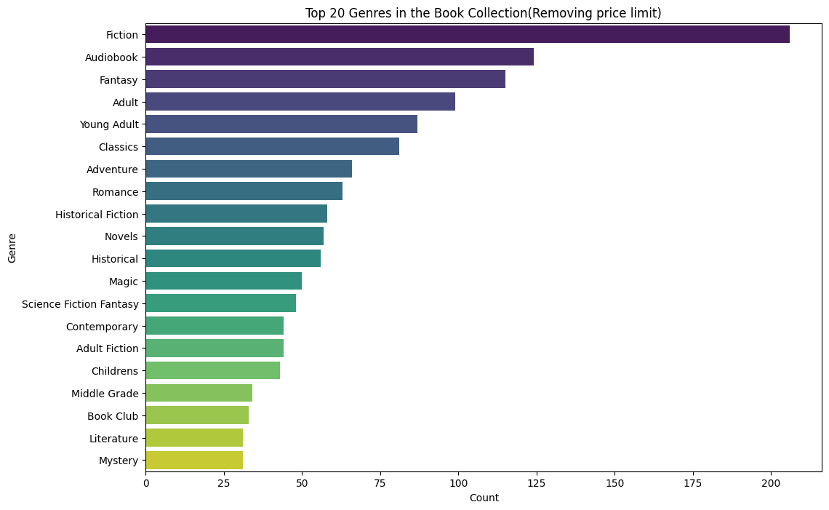
Visualization
After removing the price restriction, the number of audiobooks has increased slightly, while fantasy novels are still in the leading position.
Therefore, for many students, fantasy fictions are more attractive than literary works.（In this dataset）

Slide 7
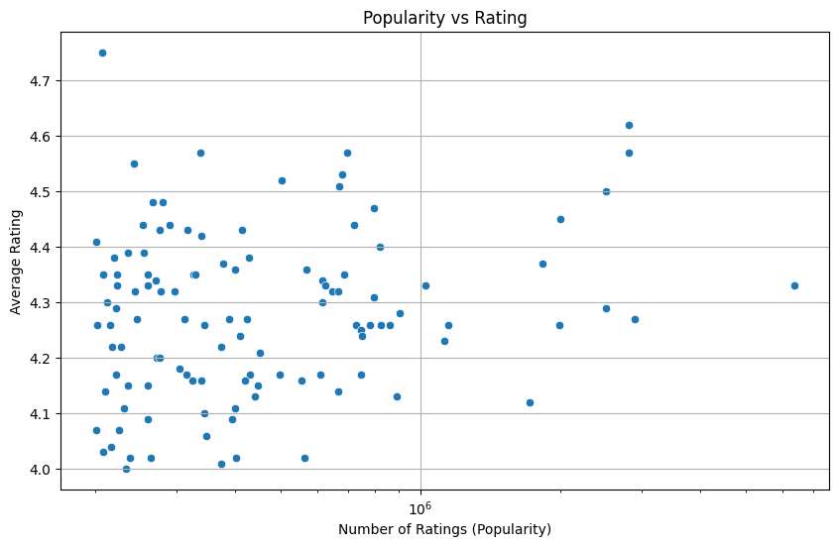
Visualization
Question: Are the high ratings of some books due to the low number of reviews?(To see if there's a correlation between the number of ratings a book receives and its average rating)
Answer: This scatter plot shows that while there's a broad range of popularity among the books, most high-rated books also receive a significant number of ratings. (This suggests that quality does correlate with popularity).

Slide 8
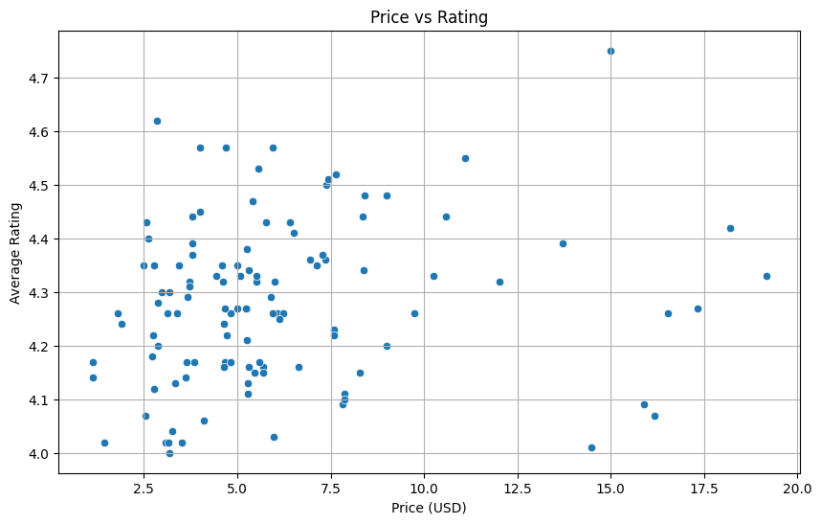
Visualization
Q: To explore the relationship between book prices and their ratings, which might indicate if higher-rated books tend to be more expensive.
A: The plot examining the relationship between price and rating does not show a clear correlation between higher prices and higher ratings. This indicates that there are many highly-rated books available at a reasonable price, which is great for building a cost-effective library collection.

Slide 9
Challenges
Data Transformation:
Extracting information from complex fields like genres or description. (To filter out books suitable for students among many books, I need to eliminate unsuitable types in the ‘description’ column. )
Solution: Create a keyword list, use re.search ,if any() and (for)loop through the entire csv file to filter the content description of these books.
Data cleaning:
Missing values or outliers in the data, especially in ‘price’ column.
Solution: Converting any non-numeric values to NaN.[ pd.to_numeric(*****, errors = ‘coerce’) ]

Slide 10
Summary
After filtering on keywords, ratings, readers’ popularity, price and reading difficulty, fictions (especially fantasy fictions) became the most choice.
There are many books with good ratings and popular among readers that are also reasonably priced. This discovery also makes my goal easier to achieve.
In fact, after I completed this assessment, I read an article in a Chinese journal that listed a list of books donated by one city in China to local poor places in 2023, and there was not any English books. Due to the lack of educational resources, most students in poor areas do not have the ability to read English works, even books with low Lexile values. I realized that there are many factors that need to be considered, and it cannot just rely on enthusiasm and hope.

